Slide 1
Chapter 05: Advanced Encryption Standard
Freshman Seminar
2022.01.14
Sumin Sohn

Slide 2
Contents
5.1 Finite Field Arithmetic
5.2 AES Structure
5.3 AES Transformation Functions
5.4 AES Key Expansion
5.5 An AES Example
5.6 AES Implementation

Slide 3
5.1 Finite Field Arithmetic

Slide 4
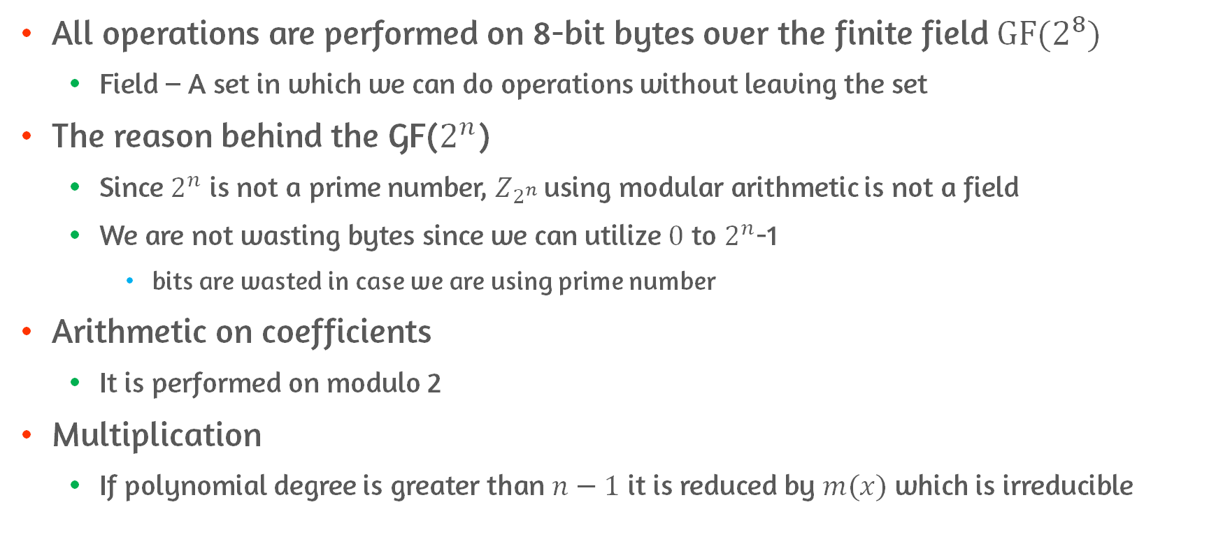
Arithmetic on AES #1
All operations are performed on 8-bit bytes over the finite field $GF(2^{8})$
Field – A set in which we can do operations without leaving the set
The reason behind the GF($2^{n}$)
Since $2^{n}$ is not a prime number, $Z_{2^{n} }$using modular arithmetic is not a field
We are not wasting bytes since we can utilize $0$ to $2^{n}$-1
bits are wasted in case we are using prime number
Arithmetic on coefficients
It is performed on modulo 2
Multiplication
If polynomial degree is greater than $n−1$ it is reduced by $m(x)$ which is irreducible

Slide 5
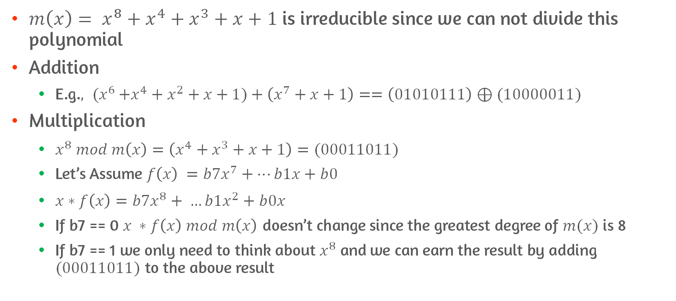
Arithmetic on AES #2
${m\left(x\right)= x}^{8}+x^{4}+x^{3}+x+1$ is irreducible since we can not divide this polynomial
Addition
E.g.${, (x}^{6}+x^{4}+x^{2}+x+1)+\left(x^{7}+x+1\right)==\left(01010111\right)⊕(10000011)$
Multiplication
$x^{8} mod m\left(x\right)=\left(x^{4}+x^{3}+x+1\right)=(00011011)$
Let’s Assume $f\left(x\right) =b7x^{7}+…b1x+b0$
$x∗f\left(x\right)=b7x^{8}+ …b1x^{2}+b0x$
If b7 == 0 $x ∗f\left(x\right) mod m\left(x\right)$ doesn’t change since the greatest degree of $m(x)$ is 8
If b7 == 1 we only need to think about $x^{8}$and we can earn the result by adding $(00011011)$ to the above result

Slide 6
5.2 AES Structure

Slide 7
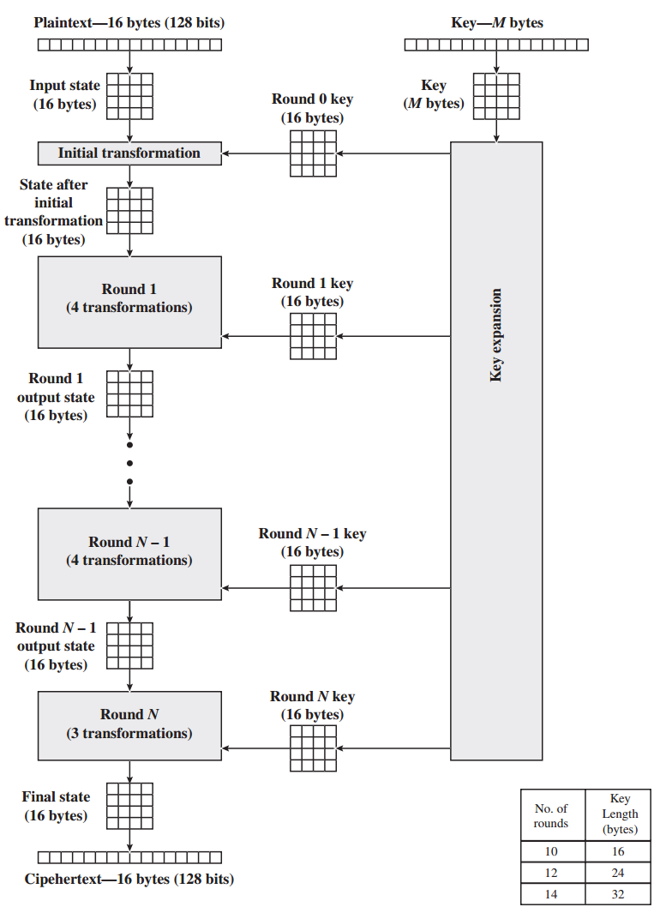
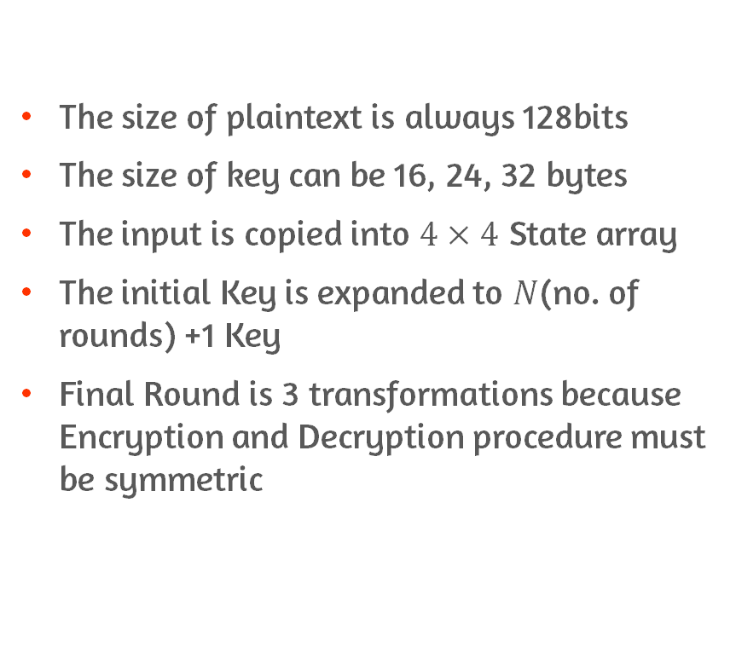
AES General Structure
The size of plaintext is always 128bits
The size of key can be 16, 24, 32 bytes
The input is copied into $4×4$ State array
The initial Key is expanded to $N$(no. of rounds) +1 Key
Final Round is 3 transformations because Encryption and Decryption procedure must be symmetric

Slide 8
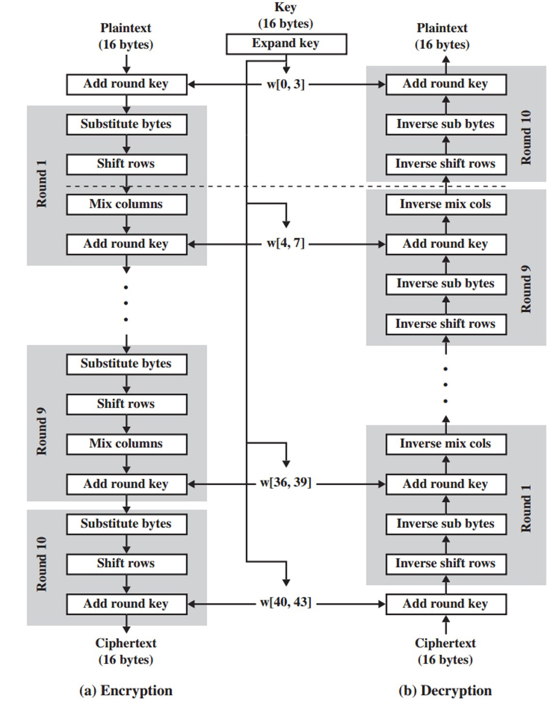
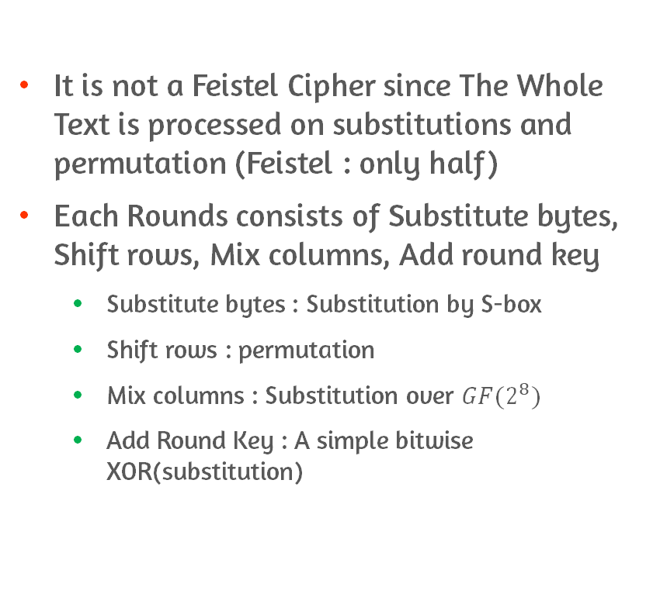
AES Detailed Structure #1
It is not a Feistel Cipher since The Whole Text is processed on substitutions and permutation (Feistel : only half)
Each Rounds consists of Substitute bytes, Shift rows, Mix columns, Add round key
Substitute bytes : Substitution by S-box
Shift rows : permutation
Mix columns : Substitution over $GF(2^{8})$
Add Round Key : A simple bitwise XOR(substitution)

Slide 9
AES Detailed Structure #2
Encryption and decryption starts with AddRoundKey
Only AddRoundKey stage add security
AddRoundKey stage is form of Vernam cipher and by itself would not be formidable
Vernam cipher = Stream Cipher Algorithm that uses XOR operations with plaintext and keystream
Each stage is reversible
The decryption algorithm makes use of the expanded key in reverse order

Slide 10
5.3 AES Transformation Functions

Slide 11
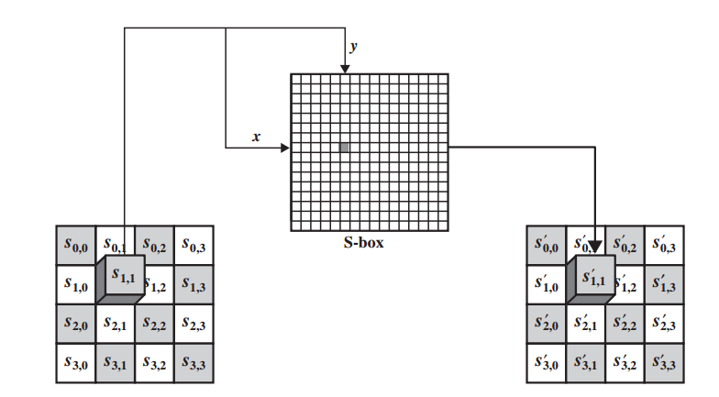
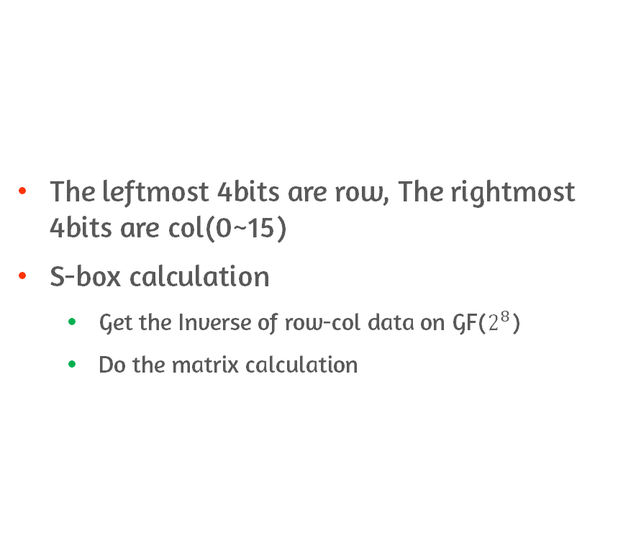
SubstituteBytes Transformation #1
The leftmost 4bits are row, The rightmost 4bits are col(0~15)
S-box calculation
Get the Inverse of row-col data on GF($2^{8}$)
Do the matrix calculation

Slide 12
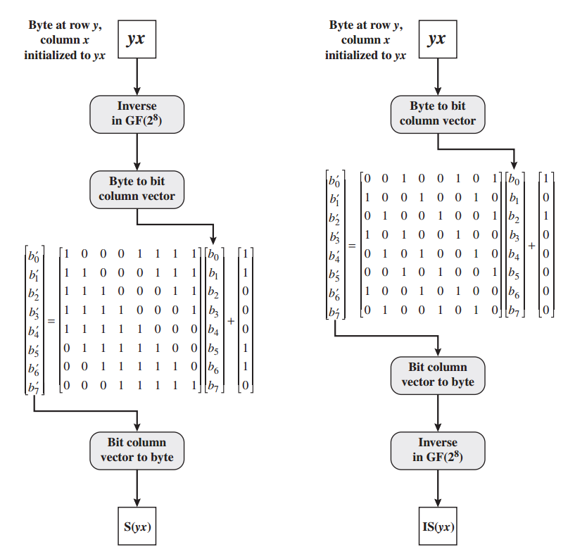
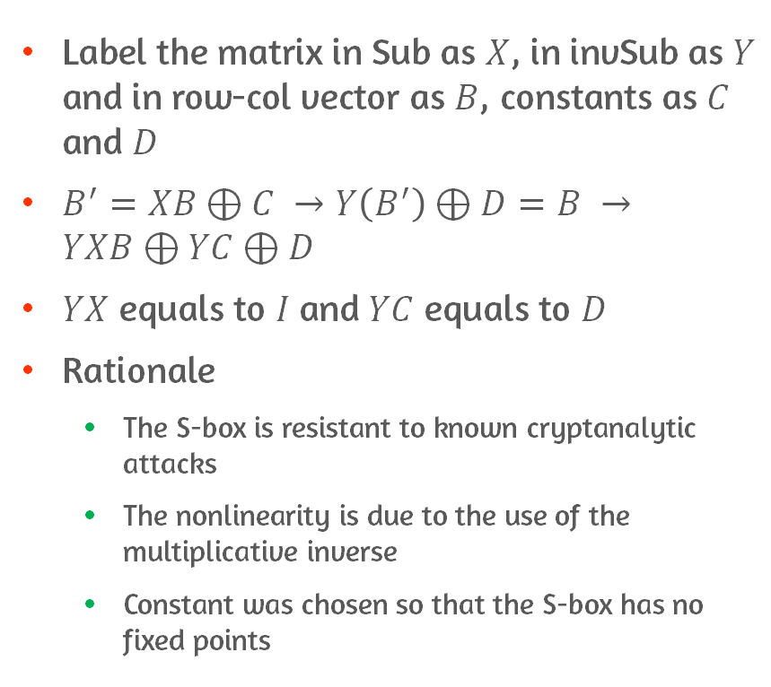
Substitute Bytes Transformation #2
Label the matrix in Sub as $X$, in invSub as $Y$ and in row-col vector as $B$, constants as $C$ and $D$
$B^{′}=XB⊕C →Y\left(B^{′}\right)⊕D=B →YXB⊕YC⊕D$
$YX$ equals to $I$and $YC$ equals to $D$
Rationale
The S-box is resistant to known cryptanalytic attacks
The nonlinearity is due to the use of the multiplicative inverse
Constant was chosen so that the S-box has no fixed points

Slide 13
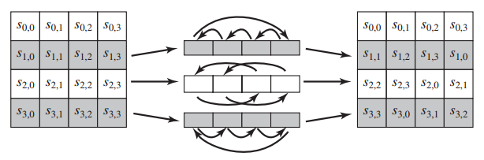
ShiftRows Transformation
Forward shift row transformation is performed on each row except first row
Rationale
The round key is applied to State column by column
A row shift moves a one column to another
4 bytes of one column are spread out to four different columns

Slide 14
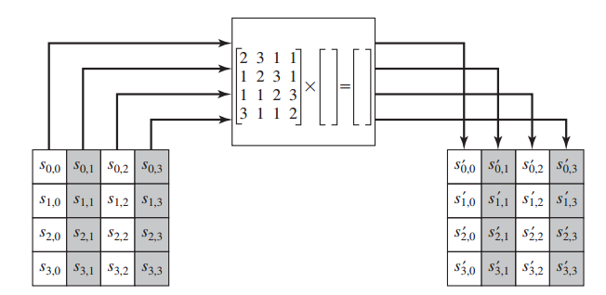
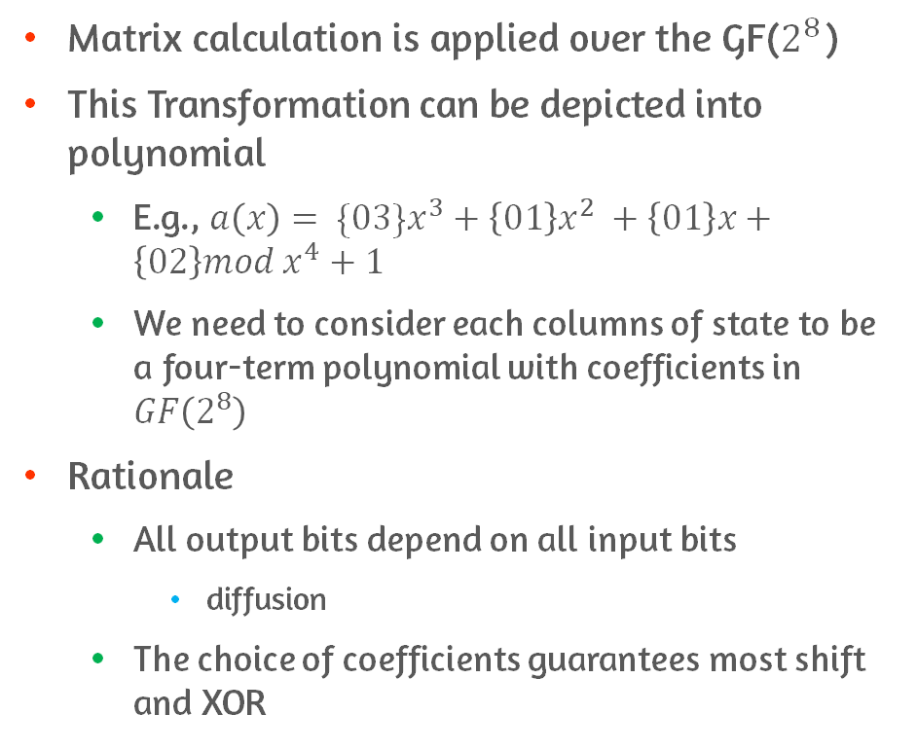
MixColumns Transformation
Matrix calculation is applied over the GF($2^{8}$)
This Transformation can be depicted into polynomial
E.g., ${a\left(x\right)= \{03\}x}^{3}+\left\{01\right\}x^{2} +\left\{01\right\}x+\left\{02\right\}mod x^{4}+1$
We need to consider each columns of state to be a four-term polynomial with coefficients in $GF\left(2^{8}\right)$
Rationale
All output bits depend on all input bits
diffusion
The choice of coefficients guarantees most shift and XOR

Slide 15
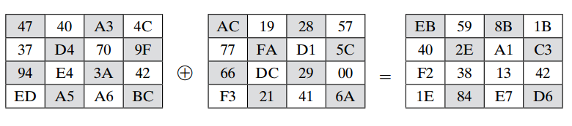
AddRoundKey Transformation
128 bits are bitwise XORed with the 128 bits of the round key
Rationale
It affects every bit of State
This is the only transformation which provides security

Slide 16
5.4 AES Key Expansion

Slide 17
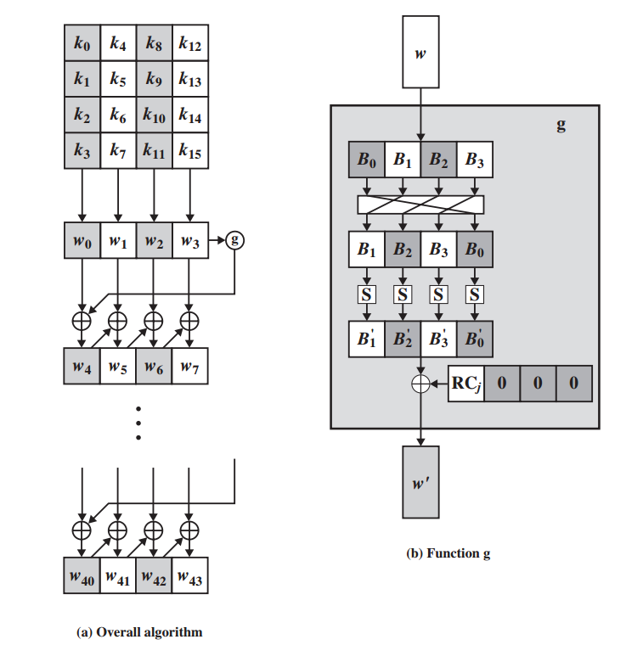
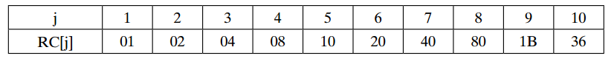
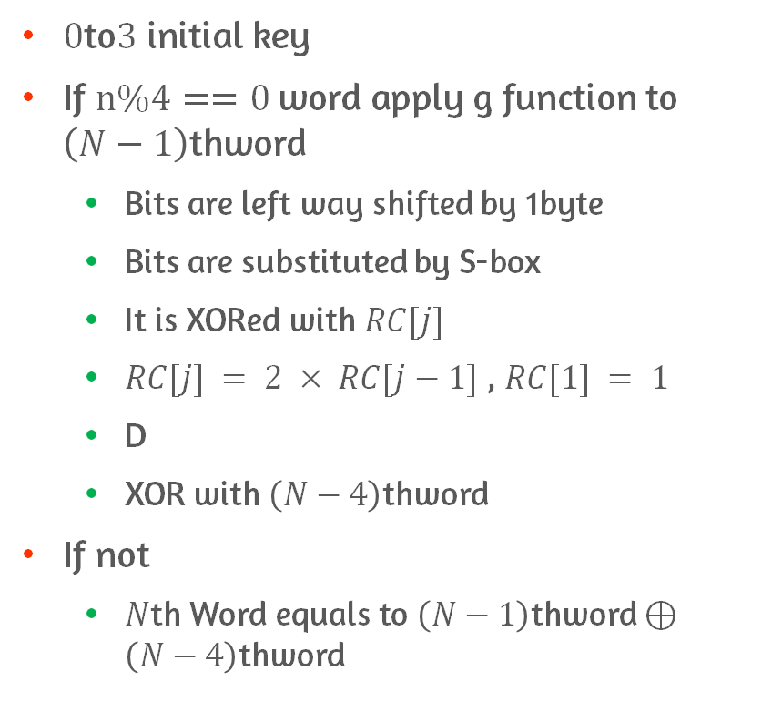
Key Expansion
$0$to$3$ initial key
If $n\%4==0$word apply g function to $\left(N−1\right)$thword
Bits are left way shifted by 1byte
Bits are substituted by S-box
It is XORed with $RC[j]$
$RC[j] = 2 × RC[j−1]$, $RC[1] = 1$
D
XOR with $\left(N−4\right)$thword
If not
$N$th Word equals to $\left(N−1\right)$thword $⊕\left(N−4\right)$thword

Slide 18
5.5 An AES Example

Slide 19
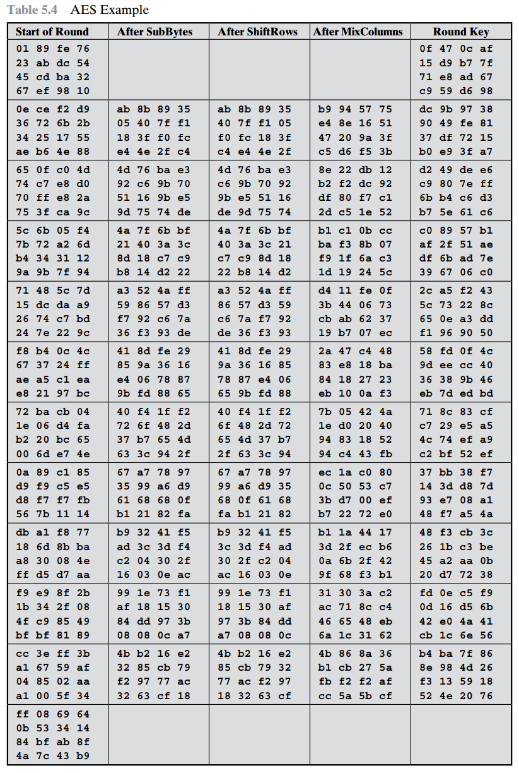
An Example
Results
Every state indicates Transformation which provides confusion and diffusion
Avalanche Effect
Small change on input bits leads to massive change on output bits
The magnitude of difference propagates through the rounds
If we select two plaintexts at random, we would expect the two plaintexts to differ 50%

Slide 20
5.6 AES Implementation

Slide 21
Equivalent Inverse Cipher
The procedures of Encryption and Decryption are not the same
However, Key share Algorithm is the same
It has the disadvantage since two separate software modules are needed
The decryption round needs to be interchanged

Slide 22
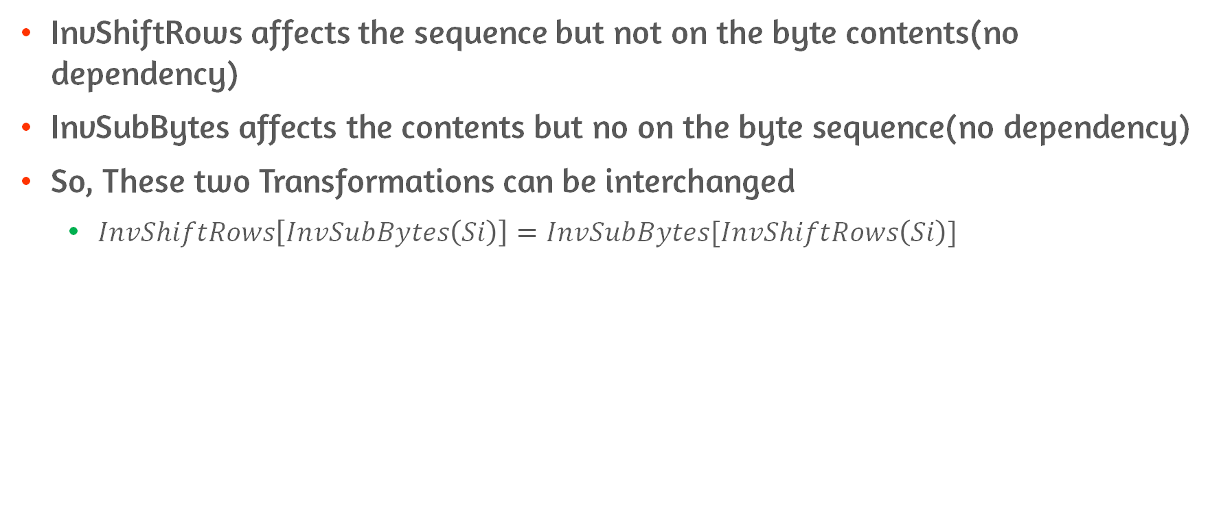
Interchanging InvShiftRows and InvSubBytes
InvShiftRows affects the sequence but not on the byte contents(no dependency)
InvSubBytes affects the contents but no on the byte sequence(no dependency)
So, These two Transformations can be interchanged
$InvShiftRows\left[InvSubBytes\left(Si\right)\right]=InvSubBytes[InvShiftRows\left(Si\right)]$

Slide 23
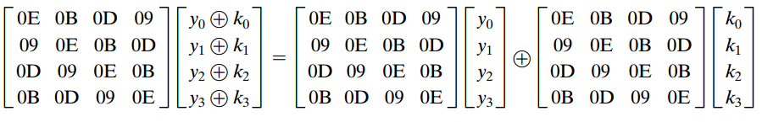
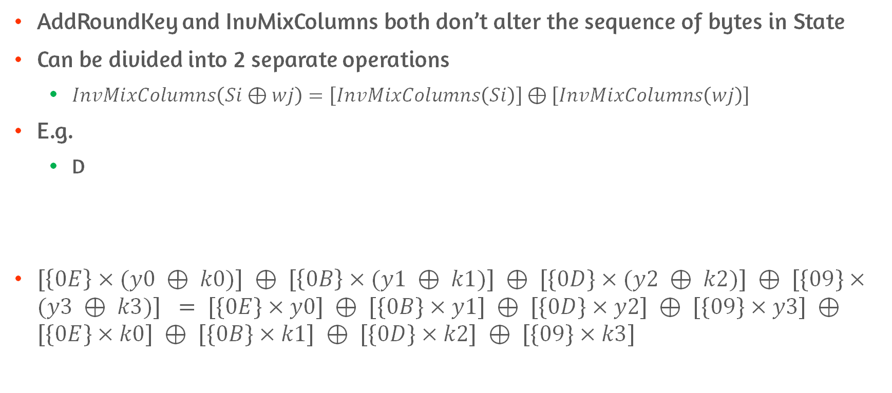
Interchanging AddRoundKey and InvMixColumns
AddRoundKey and InvMixColumns both don’t alter the sequence of bytes in State
Can be divided into 2 separate operations
$InvMixColumns\left(Si⊕wj\right)=\left[InvMixColumns\left(Si\right)\right]⊕\left[InvMixColumns\left(wj\right)\right]$
E.g.
D
$[\left\{0E\right\}×(y0 ⊕ k0)] ⊕ [\left\{0B\right\}×(y1 ⊕ k1)] ⊕ [\{0D\}×(y2 ⊕ k2)] ⊕ [\{09\}×(y3 ⊕ k3)] = [\{0E\}×y0] ⊕ [\{0B\}×y1] ⊕ [\{0D\}×y2] ⊕ [\{09\}×y3] ⊕[\{0E\}×k0] ⊕ [\{0B\}×k1] ⊕ [\{0D\}×k2] ⊕ [\{09\}×k3]$

Slide 24
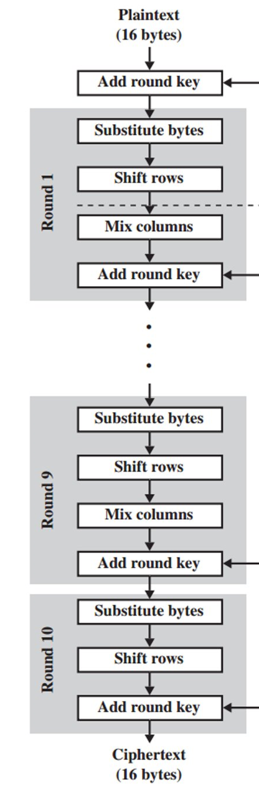
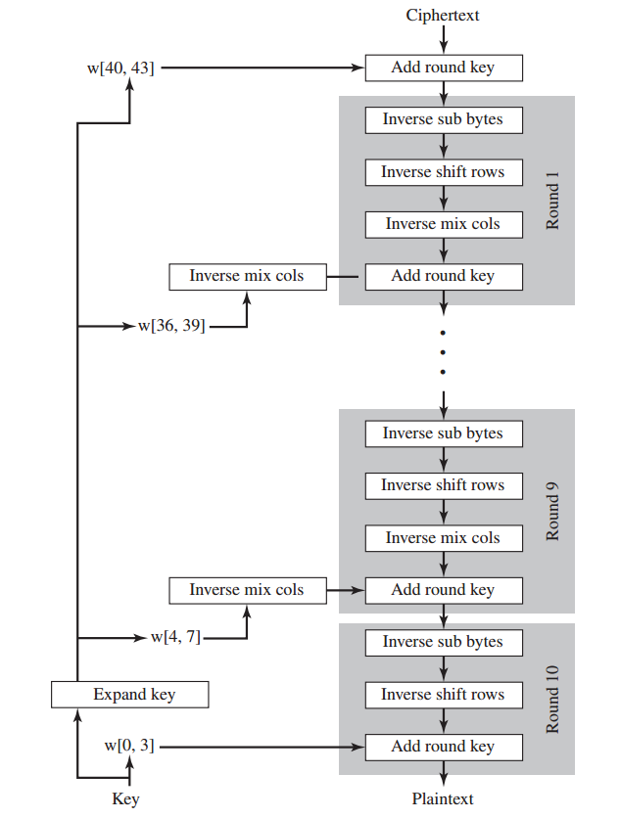
The Result of Equivalent Inverse Cipher
By making equivalent inverse cipher, we can make same decryption algorithm as encryption algorithm
Different from the previous decryption algorithm, we only need one algorithm
The key is applied on the reverse order
The key is applied after doing InverseMixColumns Except first and last round
The Only Difference between encryption and decryption is Expanded Key algorithm

Slide 25
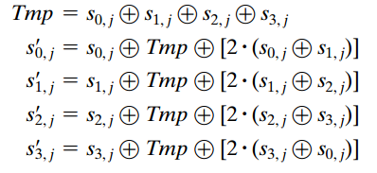
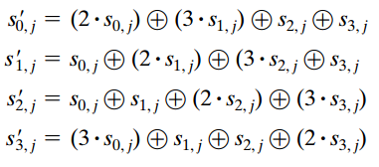
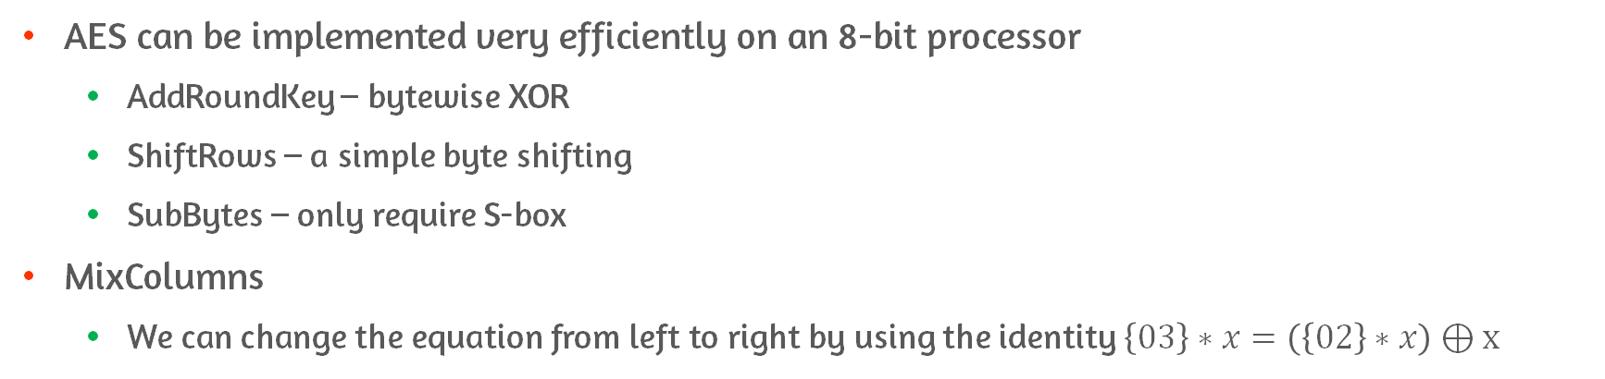
8-bit Processor Implementation
AES can be implemented very efficiently on an 8-bit processor
AddRoundKey – bytewise XOR
ShiftRows – a simple byte shifting
SubBytes – only require S-box
MixColumns
We can change the equation from left to right by using the identity $\left\{03\right\}∗x=\left(\left\{02\right\}∗x\right)⊕x$

Slide 26
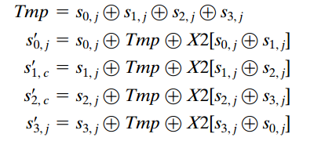
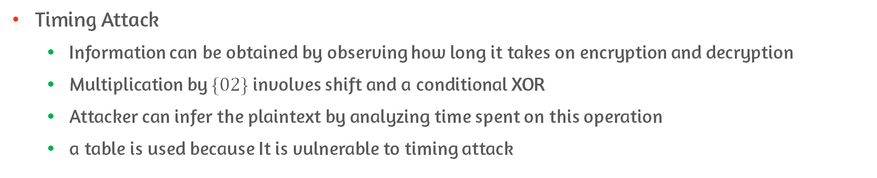
Possible Attack on MixColumns
Timing Attack
Information can be obtained by observing how long it takes on encryption and decryption
Multiplication by $\{02\}$ involves shift and a conditional XOR
Attacker can infer the plaintext by analyzing time spent on this operation
a table is used because It is vulnerable to timing attack

Slide 27
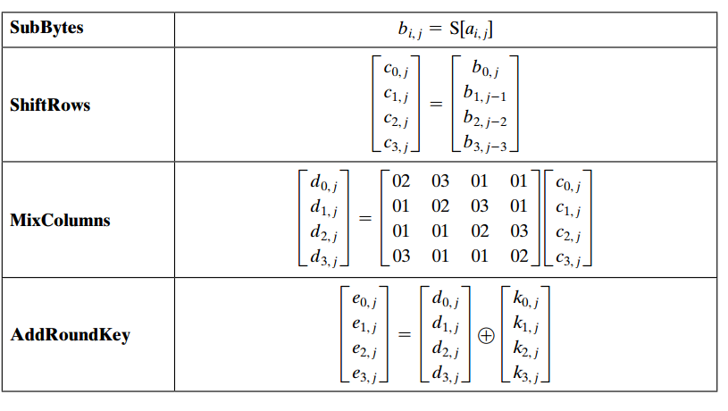
32-bit Processor Implementation
We need to process 4bytes at a same time for efficient implementation
Operations are performed on the columns
All other operations are defined on 32-bit words

Slide 28
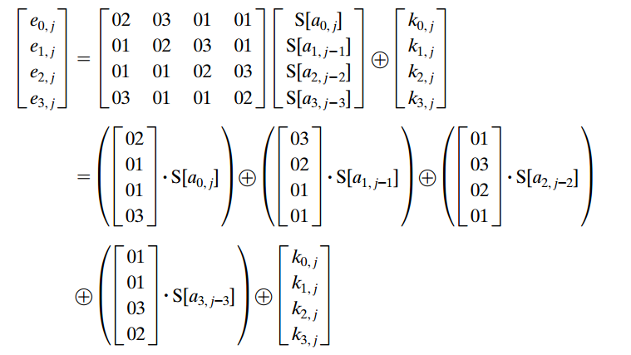
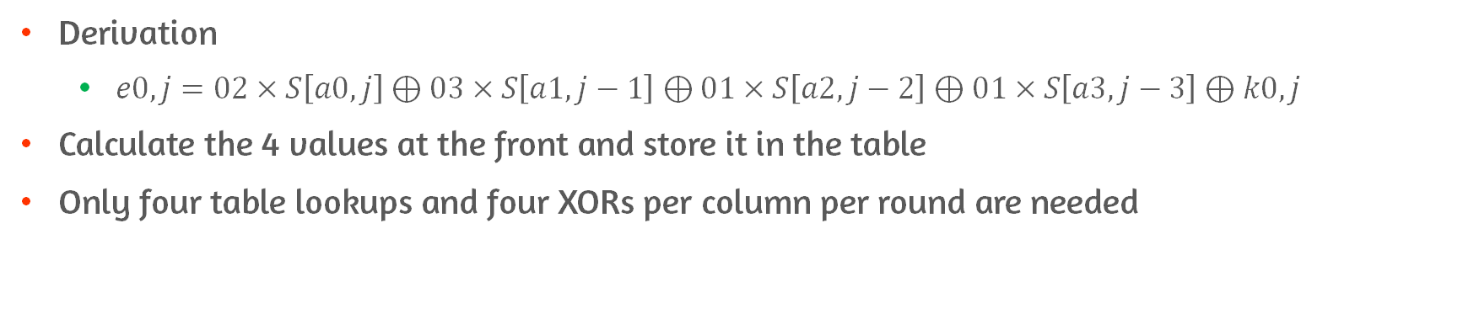
MixColumns on 32-bit Processor
Derivation
$e0,j=02×S\left[a0,j\right]⊕03×S\left[a1,j−1\right]⊕01×S\left[a2,j−2\right]⊕01×S\left[a3,j−3\right]⊕k0,j$
Calculate the 4 values at the front and store it in the table
Only four table lookups and four XORs per column per round are needed

Slide 29
Conclusion
Finite Field Arithmetic
Arithmetic on AES
AES Structure
AES Transformation Functions
AES Key Expansion
An AES Example
AES Implementation
8-bit Processor
32-bit Processor

